Slide 1
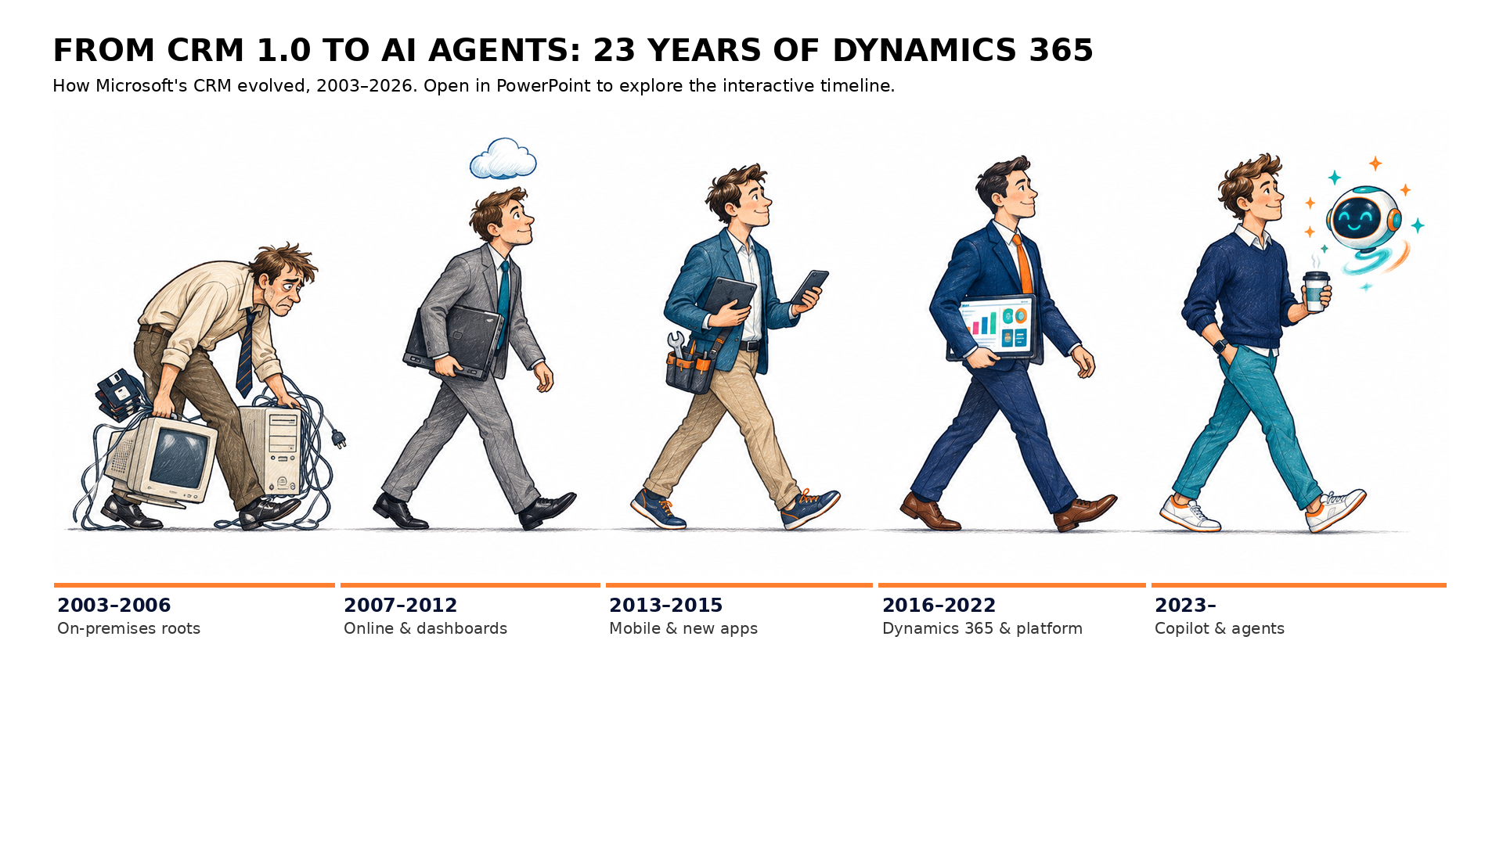
Dynamics 365 CRM history 2003–2026
Notes:
Microsoft's CRM has evolved over 23 years from an on-premises Outlook companion (CRM 1.0, January 2003) into Dynamics 365 with Copilot and autonomous agents. Key turning points: CRM 3.0 adds marketing (2005), CRM Online launches (April 2008), CRM 2011 brings dashboards and charts, FieldOne is acquired (July 2015) to become Field Service, Dynamics 365 launches on 1 November 2016, the Unified Interface arrives with v9.0 (2017), Dynamics 365 Marketing arrives in April 2018, release waves start in 2019, Dataverse follows in 2020, Copilot in March 2023 and autonomous agents in October 2024.
Using this slide:
Click one of the five figures or an era label to jump to that era. Click any dot on the timeline to see what that milestone brought. Use the Prev / Next buttons or the left and right arrow keys to walk through all 28 milestones in order.

